Slide 1
C♯ Dependency Injection Testing Entity Framework
Rasmus Lystrøm
Associate Professor
ITU
rnie@itu.dk

Slide 2
Agenda
Note on virtual
Testing …
Dependency Injection
Stubbing and mocking
Testing Entity Framework

Slide 3
Virtual
Autogenerated
public partial class FuturamaContext : DbContext
{
public virtual DbSet<Character> Characters { get; set; }
}
public class SuperheroContext : DbContext
{
public DbSet<Superhero> Superheroes { get; set; }
}

Slide 4
Virtual
Allow lazy loading of City
public class Superhero
{
public int Id { get; set; }
public virtual City City { get; set; }
public ICollection<SuperheroPower> Powers { get; set; }
}
Do not allow lazy loading of Powers

Slide 5
Testing …
Testing live databases is hard
Testing live full systems is hard
By transitivity: Testing … is hard…

Slide 6
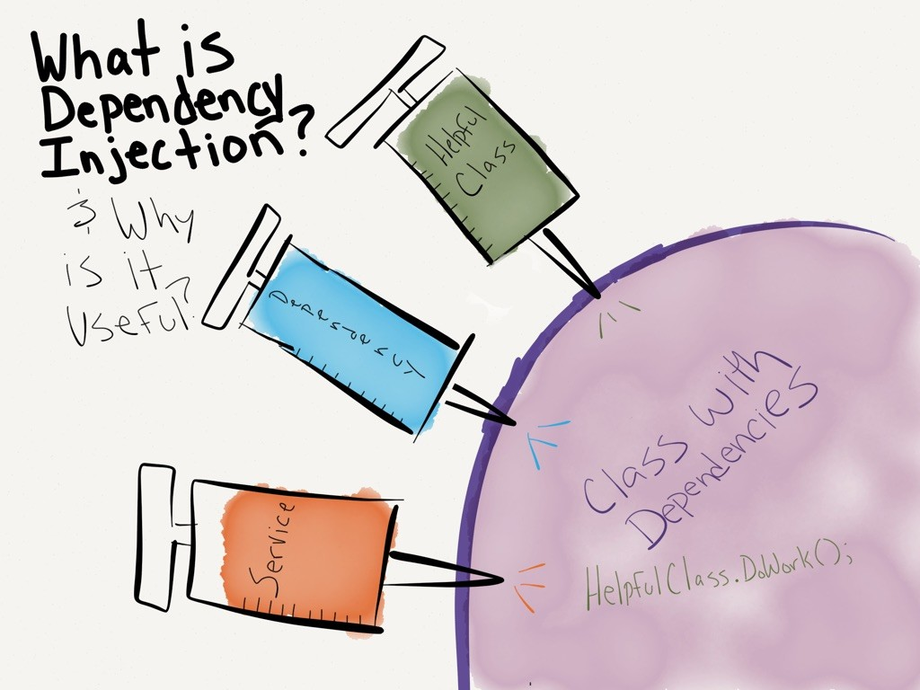
http://dwiardiirawan.com/index.php/2016/05/18/what-is-dependency-injection-and-what-are-the-advantage/

Slide 7
Dependency Injection
Software design pattern which implements Inversion of Control (IoC)

Slide 8
Dependency Injection (DI)
Constructor Injection
Property (Setter) Injection
Interface Injection

Slide 9
Dependency Injection
Structured readable code
Testable code
Dependency Inversion Principle
Separation of Concerns
Rock SOLID!!!
AWESOME!!
Pun intended

Slide 10
Programming to interface, not implementation…
public interface IFooService
{
bool Bar(Foo foo);
}
public class FooService : IFooService
{
bool Bar(Foo foo)
{
// Implementation
}
}
public interface IFooMapper
{
Foo Map(Qux qux);
}

Slide 11

Using IFooService ?
public class Baz
{
public bool Grault(Qux qux)
{
IFooMapper mapper = new FooMapper();
var foo = mapper.Map(qux);
IFooService service = new FooService();
return service.Bar(foo);
}
}

Slide 12
Constructor Injection (preferred)
public class Baz
{
private readonly IFooMapper _mapper;
private readonly IFooService _service;
public Baz(IFooMapper mapper, IFooService service)
{
_mapper = mapper;
_service = service;
}
public bool Grault(Qux qux)
{
var foo = _mapper.Map(qux);
return _service.Bar(foo);
}
}
Private readonly fields
Initialize from constructor

Slide 13
Property Injection
Public setter
public class Baz
{
public IFooService Service { private get; set; }
public bool Grault(Qux qux)
{
...
return Service?.Update(foo);
}
}
Is this King?

Slide 14
Interface Injection
public interface IServiceSetter<T>
{
void SetService(T service);
}
public interface IServiceSetter<T>
{
T Service { set; }
}

Slide 15
Interface Injection II
Interface
public class Baz : IServiceSetter<IFooService>
{
private IFooService _service;
public void SetService(IFooService service)
{
_service = service;
}
public bool Grault(Qux qux)
{
// Implementation
}
}
Implement interface

Slide 16
Interface Injection III
Interface
public class Baz : IServiceSetter<IFooService>
{
public IFooService Service { private get; set; }
public bool Grault(Qux qux)
{
// Implementation
}
}
Implement interface

Slide 17
Best practices
Use Adapter to enable interface if needed
Use constructor injection
Program to interface
Use an IoC container
More on this in a couple of weeks...

Slide 18
IoC Container
dotnet add package Microsoft.Extensions.DependencyInjection
IServiceCollection services = new ServiceCollection();
services.AddScoped<IService, Service>();
var provider = services.BuildServiceProvider();
var service = provider.GetRequiredService<IService>();

Slide 19
Unit Testing Best Practices (recap)
Never test against a live database, file, or web service
01
Single Responsibility Principle
02
Only test the ”System Under Test”
03
Atomic tests
04
Use either mocks or stubs
05

Slide 20
Stubbing and mocking

Slide 21
Stubs
public class FooServiceFalseStub : IFooService
{
public bool Bar(Foo foo)
{
return false;
}
}

Slide 22
Stubs
[Fact]
public void Exec_when_IFooService_Update_returns_false_returns_false()
{
IFooService service = new FooServiceTrueStub();
var baz = new Baz(service);
var result = baz.Exec(new Foo());
Assert.False(result);
}

Slide 23
Mocks
[Fact]
public void Exec_when_IFooService_Update_returns_false_returns_false()
{
var mock = new Mock<IFooService>();
IFooService service = mock.Object;
var baz = new Baz(service);
var result = baz.Exec(new Foo());
Assert.False(result);
}

Slide 24
Mocks
[Fact]
public void Exec_when_IFooService_Update_true_returns_true()
{
var mock = new Mock<IFooService>();
mock.Setup(m => m.Update(It.IsAny<Foo>())).Returns(true);
var baz = new Baz(mock.Object);
var result = baz.Exec(new Foo());
Assert.True(result);
}

Slide 25
Demo
White-box testing with Moq

Slide 26
Testing Entity Framework

Slide 27
SQLite in-memory database
dotnet add package Microsoft.EntityFrameworkCore.Sqlite
using var connection = new SqliteConnection("Filename=:memory:");
connection.Open();
var builder = new DbContextOptionsBuilder<MyContext>().UseSqlite(connection);
using var context = new MyContext(builder.Options);

Slide 28
Demo
Black box testing with SQLite in-memory

Slide 29
Best practices
Wrap in logical units/service classes/repositories
Don’t test built-in code…
Program to interface

